Slide 1
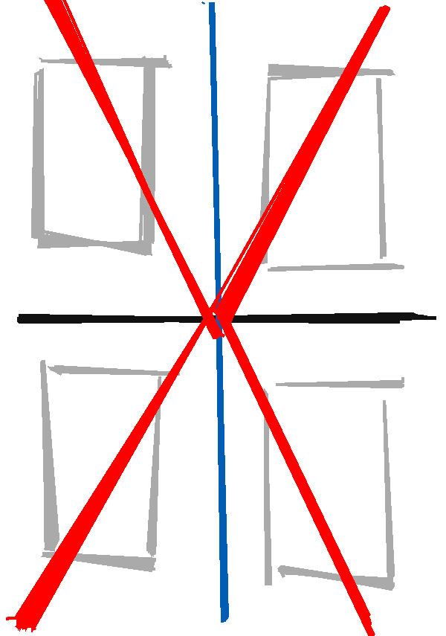
Physical Divide
Ripples through time
Ripples through time
Shared experience
Gender Divide
Ripples through time
Ripples through time

